Slide 1
David Zhou CEO / Director
David, co-founder and CEO of VXI Global Solutions, is primarily responsible for operational steering, strategic planning, investments in new technologies, and key client relationships. David has helped the company grow into a leading provider BPO and ITO services from its humble beginnings in 1998.
David holds a Master’s Degree in Nuclear Physics from the Institute of Plasma Physics, and an MBA from Pepperdine University.
LinkedIn

Slide 2
Eva Wang Founder / Director
Eva is the co-founder and guiding visionary at VXI. Since co-founding the company in August 1998, under her stewardship, VXI has grown globally to 43 contact center locations and over 40,000 employees worldwide.
Prior to founding VXI, she co-founded and served as the President of the Asian American Association, a teleservices marketing company, with David Zhou. A science graduate from the University of Nanjing, Eva has featured in leading business publications and is often invited to speak around the country about her experiences as an Asian American entrepreneur.
LinkedIn

Slide 3
Frank Yao President / Director
Frank Yao brings a wealth of expertise in driving growth and fostering innovation to his role as President and Chief Commercial Officer at VXI Global Solutions. With a background in private equity and consulting, Frank has honed his skills in portfolio management, cross-border deals, and strategic leadership.
Prior to VXI, Frank served as a Managing Director at Bain Capital Private Equity, where he facilitated multinational corporations and founder-led organizations in capitalizing on market opportunities. Now, at VXI, Frank is dedicated to deepening customer relationships, unlocking new opportunities for value creation, and driving growth.
LinkedIn

Slide 4
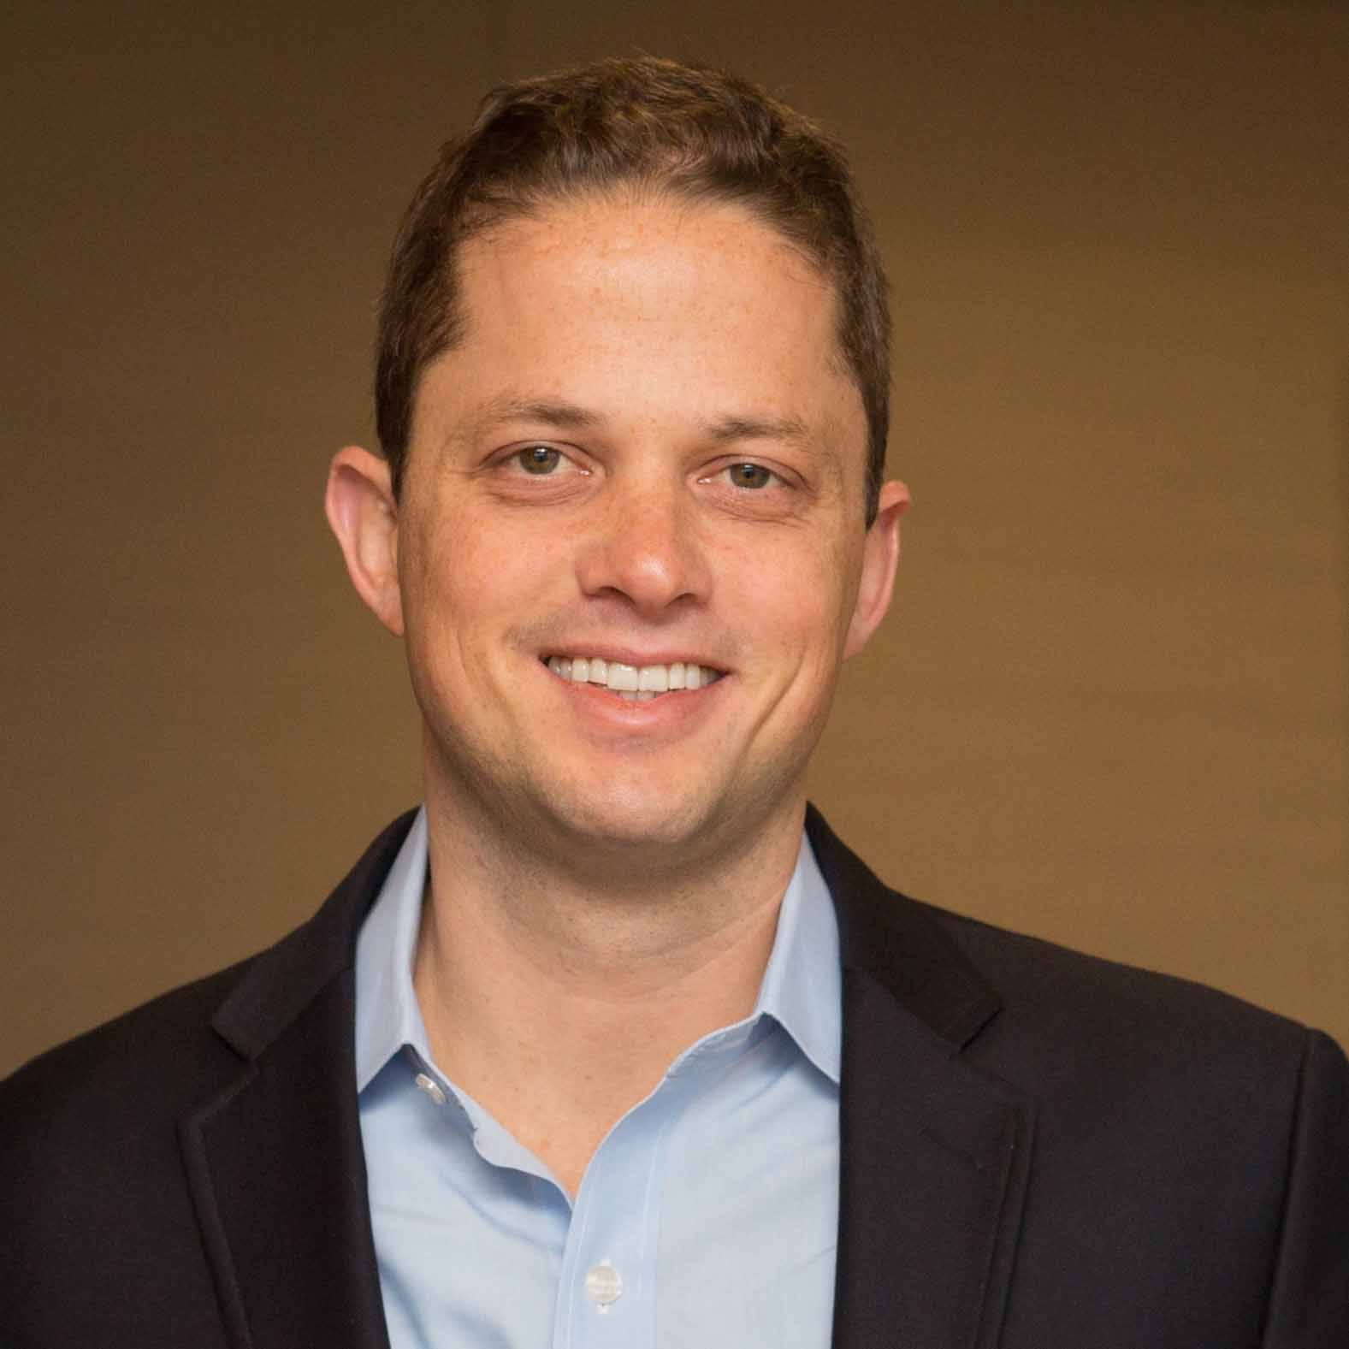
Eric Erb Director
Erb joined Bain Capital in 2009. He is a Partner in the Financial & Business Services and Technology, Media & Telecommunications Verticals and is a member of the Asian Pacific Private Equity team. He also serves as a member of the firm’s recruiting team.
Prior to joining Bain Capital, Mr. Erb was a consultant at the Boston Consulting Group, where he served consumer/retail and industrials clients in North America and Asia.
Mr. Erb received an MBA from Harvard Business School. He graduated cum laude from Dartmouth College with a BA in Economics.
LinkedIn
Partner
Bain Capital Private Equity (Hong Kong), LLC

Slide 5
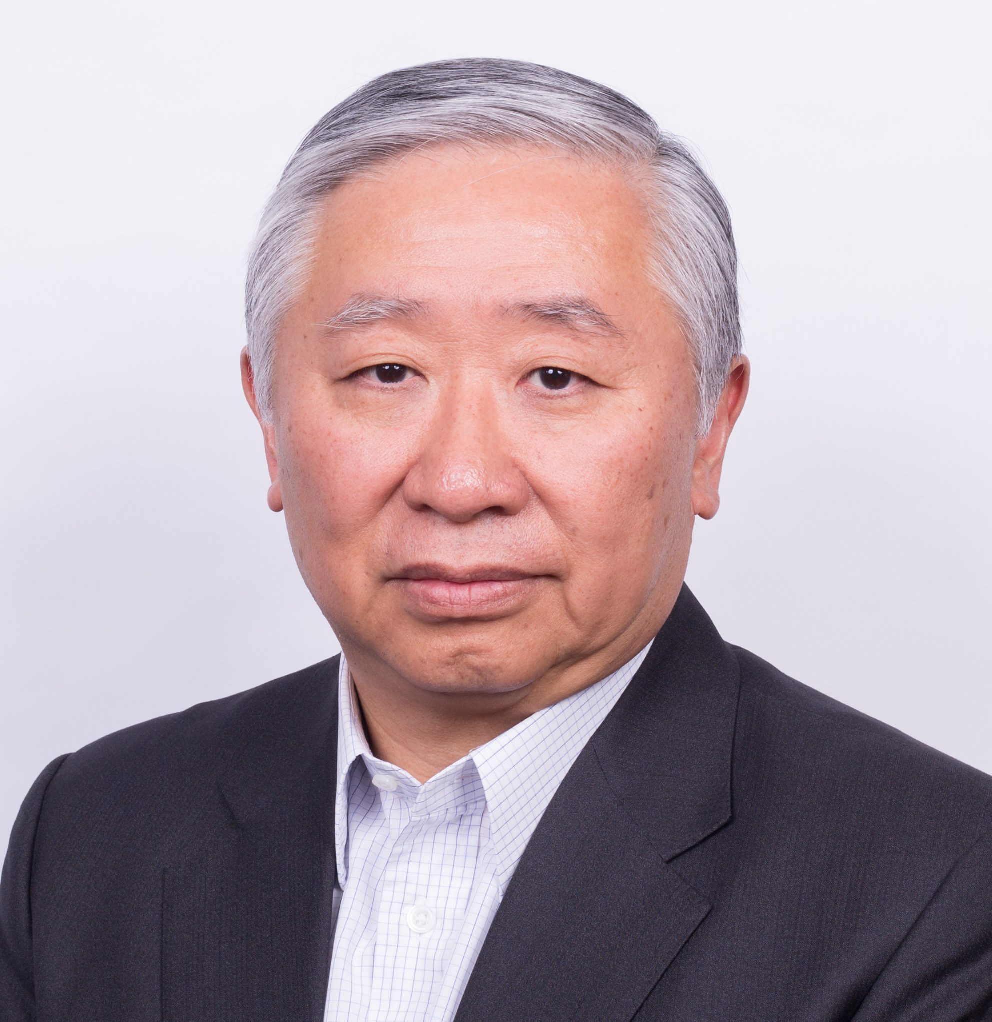
Jonathan Zhu Director
Jonathan Zhu is a Partner of Bain Capital and Co-Head of Asia Private Equity, based in Hong Kong. Since joining Bain Capital in 2006, Mr. Zhu has led many of Bain Capital’s investments in Asia, with a focus on China. Mr. Zhu is currently an independent non-executive director of Sunac China Holdings Limited, the shares of which are listed on the Stock Exchange of Hong Kong.
Mr. Zhu is also a director of ChinData Group, the shares of which are listed on NASDAQ. Before joining Bain Capital in 2006, he was the China Chief Executive Officer of Morgan Stanley. Mr. Zhu holds a juris doctor degree from Cornell Law School, an MA degree from Nanjing University, and a BA degree from Zhengzhou University. Mr. Zhu is a trustee of Cornell University and Chairman of its China Advisory Board.
LinkedIn - NA
Partner and Co-head of Asia Private Equity
Bain Capital Private Equity (Asia), LLC

Slide 6
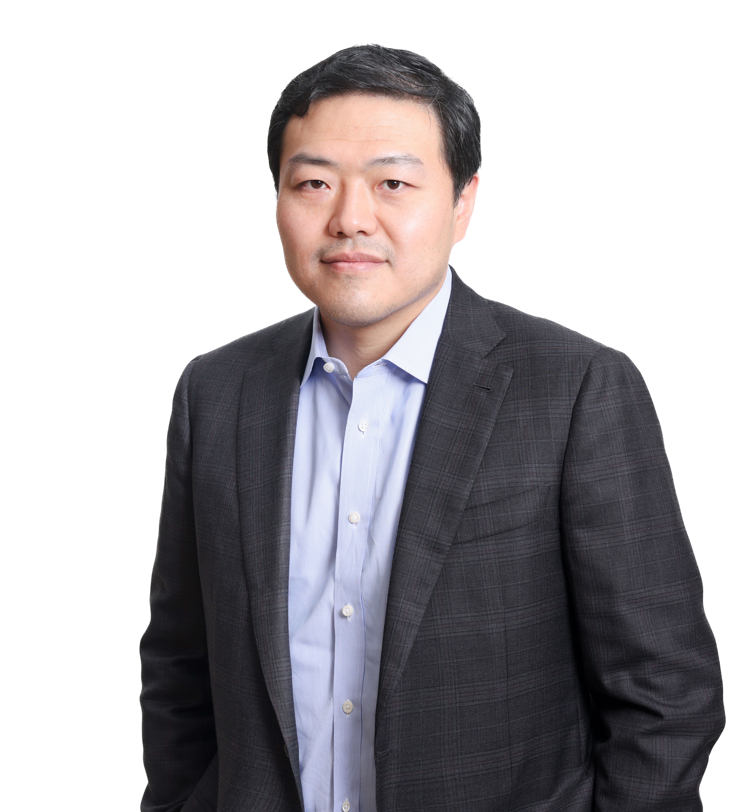
Drew Chen Director
Drew Chen is currently a Partner with Bain Capital Asia, responsible for Bain Capital’s private equity investments in Greater China and Asia Pacific region, focusing primarily on telecom, media and technology sectors, as well as business and financial services sectors.
Mr. Chen joined Bain Capital’s Boston headquarter in 2005, and transferred to Hong Kong in 2007 as a founding member of Bain Capital Asia. He participated in and led a number of important transactions in both the US and Asia for Bain Capital, including: public to private transaction of the largest US casual dining restaurant group OSI Restaurant Partners (relisted as Bloomin’ Brands “BLMN”), Princeton Review, Greatview Aseptic Packaging (468.HK), Gome Electronics (493.HK), ASIMCO Auto Components Group , Zhejiang Uniview Technologies, VXI, Rise Education (NASDAQ: REDU), China PnR, Newlink Technology Limited (NASDAQ: NAAS) and Asia’s leading hyperscale data center provider ChinData Group. Previously Mr. Chen worked for Bain & Company.
Born in Shanghai, Mr. Chen was educated in China, the UK and the US. He holds a bachelor degree in economics from Harvard College and an MBA degree from Harvard Business School.
LinkedIn - NA
Partner
Bain Capital Private Equity (Asia), LLC

Slide 7
Lihong Wang Director
Lihong Wang is currently Chairwoman and CEO of Rise Education Group,
a leading afterschool education company in China. She has been a director
of Rise Education since 2013 and the Chairwoman since 2017. Started in
June, 2023, she is also the Chairwoman of Subway China (Shanghai Fu-
Rui-Shi Corporate Development Co., Ltd.), a master franchisee of Subway in
Mainland China. Prior to these roles, Ms. Wang had worked at Bain Capital
Private Equity Asia Limited from July 2006 to December 2019. She served
as Managing Director/Partner since 2011. Ms. Wang has more than 30
years of experience in the financial industry in the United States and Asia.
She was responsible for Bain Capital’s private equity activities in China, sit
on the Asia Investment Committee, and led investments and portfolio
management efforts in China. She is an Independent Non-Executive
Director (INED) for Hong Kong-listed company Sunac Services Holdings
Limited (1516.HK) and DPC Dash Ltd (1405.HK, Domino’s Pizza China).
She also serves as a director for a number of portfolio companies in which
Bain Capital has invested.
LinkedIn
Chairwoman and CEO, Rise Education Group; Chairwoman, Subway

Slide 8
Lihong Wang Director
Before joining Bain Capital in July 2006, Ms. Wang was an executive
director at Morgan Stanley from April 2005 to July 2006. She worked at JP
Morgan Securities Asia Pacific Limited from October 2001 to March 2005
and at Credit Suisse First Boston from September 1999 to September 2001.
Before attending Columbia Business School, Ms. Wang worked for the
China Securities Regulatory Commission, where she oversaw Chinese
companies’ overseas listings. Ms. Wang obtained an MBA from Columbia
Business School and is a graduate of Fudan University. She lives in Hong
Kong with her husband, Zhihong Li ’99, and their two children.
Ms. Wang established two scholarships with academic institutes: the
Lihong Wang Academic and Research Growth Fund for students at the
Fudan Management School and the Lihong Wang ’99 and Zhihong Li ’99
Scholarship at Columbia Business School.
LinkedIn
Partner
Bain Capital Private Equity (Hong Kong), LLC

